Slide 1

MODUL 7
LAB. DASAR PEMROGRAMAN

Slide 2

Sub program which located outside the main program that returns a value (return value) of a certain type (basic type or types of formation)
Purpose of the function:
Program become structured and easy to understand
Avoid writing a repetitive code

Slide 3

function_type function_name(parameter1, parameter2,..)
{
statement function;
}
Example :
int add(int x, int y)
{
return(x+y);
}

Slide 4

Prototipe= function declaration
function_type function_name(parameter_type1, parameter_type2,..);
Example :
int add(int a, int b);

Slide 5
#include <stdio.h>
#include <stdlib.h>
int add(int a, int b);
int a,b,c;
main()
{
printf(“Input a: ");scanf("%d",&a);
printf(“Input b: ");scanf("%d",&b);
c=add(a,b);
printf(“Total = %d",c);
}
int add(int x, int y)
{
return(a+b);
}
//function prototype
//main program
//function

Slide 6
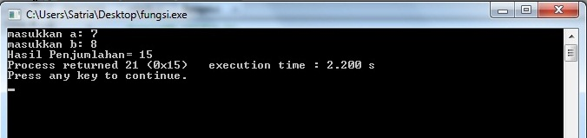

Slide 7

Parameter Formal
Parameter Aktual

Slide 8

Variables that exist in the parameter list in the function definition
Parameter formal
int add(int x, int y)
{
return(x+y)
}

Slide 9

Parameters used in function call
main()
{
. . .
. . . Parameter aktual
c=jumlah( a, b );
. . .
}

Slide 10

Call with a value (call by value)
The value of the actual parameters are copied into the formal parameter
Call with the reference (call by reference)
Call by passing the address of a variable into the function.

Slide 11

Global variable
Local variable
Static variable

Slide 12

Local variable=variable that declare inside the function
Global variable=variable that declare outside the function

Slide 13

#include <stdio.h>
#include <stdlib.h>
/*Global variable*/
float proses(float,float,float);
float p,l,t,volumebalok;
main()
{
printf(“masukkan panjang : ");
scanf("%f",&p);
printf("masukkan lebar : ");
scanf("%f",&l);
printf("masukkan tinggi : ");
scanf("%f",&t);
volumebalok=proses(p,l,t);
printf("volume : %.2f", volumebalok);
}
float proses(float x,float y,float z)
{
/*Local variable*/
float v;
v= x * y * z ;
return(v);
}

Slide 14
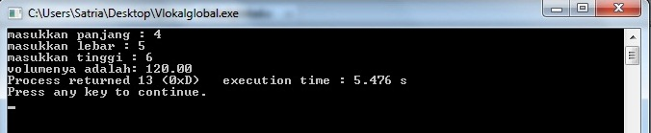

Slide 15

variable whose value will be retained even if the process has been out of the block function

Slide 16

#include <stdio.h>
#include <stdlib.h>
long int faktorial(int n);
void main()
{
int bil,i;
long int fak;
printf("Masukkan bilangan: ");
scanf("%d",&bil);
for (i=1;i<=bil;i++)
{
fak=faktorial(i);
}
printf("Faktorial %d = %d",bil,fak);
}
long int faktorial(int n)
{
static long int fak=1;
fak=fak*n;
return (fak);
}

Slide 17
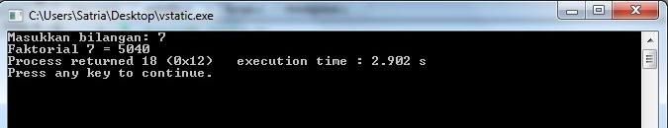

Slide 18


